Slide 1
Project Essentials
STEPS TO TEAM PROJECT SUCCESS
DAVE FOYE- JANUARY 2016

Slide 2

Outline
Introduction
Definition- What is a Project? Key Ideas, Project Plan, and Team Principles
Step 0- You- the Team
Step 1- Goals and Requirements, Project Environment- What?, Where?
Step 2- Resources and Limitations- How?, When?
Step 3- Team Process and Management- Who?
Project Planning
Project Execution and Control
Tools, Measurements and Success

Slide 3

Introduction
Presenter- Dave Foye
  Experience- 40 years with Trane Co.; Engineering Manager and Senior Technologist (retired 2013)
  Project leader and Project leader-coach; Product development
    Project durations: 3 months to 7 years
    Project sizes:
      - Products: $500K to $10M, Investigations $10K to $2M
      - Team size: 5 to 25 internal staff; external resources from 10 to 50 staff
  Project Coach to large and small projects. Technology investigations, product design and development, and product problem investigations

Slide 4

Definition
Project-
a planned piece of work that has a specific purpose
(such as to find information or to make something new)
and that usually requires a lot of time; typically involves a team
Observation:
Generally always involves some learning and surprises or changes ! And therefore, re-planning….It is rare for any large team project to follow the original plan…

Slide 5
Some Key Ideas
Planning- A process of using the best information available to select a best fit of resources and tasks. The goal is to reduce risk, time and energy cost, and make good use of team member’s time to create the best practical benefits.
Types of Projects
  Simple- knowledge is fairly complete, tasks are known, all work is done within the team, materials/methods/techniques are known, team availability is adequate, and available time is adequate.
  Complex- Dependencies exist outside the team, tasks and technical knowledge is incomplete, funding and time are limited.
  Between simple(low risk) and complex(high risk)- most projects exist !
  Choices of Methods and tools to use depends on team makeup, type of project, timeframe,…
  So, how do we proceed ???

Slide 6
The General Project Challenge- the Plan
The Project Team needs to gather information and arrive at a plan:
1) Understand the goals and limitations(time, resources, authority, etc.)
2) Understand the team resources (abilities, talents, preferences, limitations)
3) Identify the elements of success(how will the team and output be measured)
4) Identify the technical strategy (what needs to be done- how will the technical selections do it)
5) Decide the logistic strategy(what must be done when and by whom)
6) Decide the delivery strategy(how will the outcome be delivered)
How do you know you have a good plan??
How does a team do this??

Slide 7
Team Principles
Every Team Needs to work together to be successful !
Every Project Team Member Must Help the Team !
The Project Team Must Use Each Team Member Abilities Efficiently !
So, ALL TEAMS EVOLVE IN FOUR STEPS:
  Forming- Learning about each other’s abilities, needs, and goals
  Storming- The process of sharing ideas, learning about the project and jobs to be done, learning how the team can be best organized between leaders and followers
  Norming- The process of reducing ideas into a plan that is shared and held between all team members, with all team members knowing their roles, and having their questions answered to allow progress
  Performing- Completing team tasks, assembling the project result, and delivering the project for success
These steps will be repeated as necessary if incomplete, if too many assumptions are made, or project disruption occurs….

Slide 8
Step 0- You- the Team
Learning-
  Who is the team?
  What can they do? What are the skills and abilities?
  What does each member need and/or want?
  Developing and Understanding of:
  What are the team internal resources
  How will the team work together

Slide 9
Step 1- Goals and Requirements, Project Environment- What?, Where?
Team works to answer the questions:
What must the project do? What must the project deliver?
What is the project environment-
  What are the project resources provided?

Slide 10
Step 2- Resources and Limitations- How?, When?
Team works to answer the questions:
When must the project results be delivered? How and in what form?
Are there intermediate delivery steps required?
What are the external resources and limitations (money, materials, external team members)
What are the information resources? Is assistance available?

Slide 11
Step 3- Team Process and Management- Who?
Every Team is Different- Different People, Different Skills, Varying Goals and Needs
Team Evolution- This cannot be avoided !
  Team steps- Forming, Storming, Norming, Performing
What are the project team roles needed? Who will fill the roles?
  Who will serve to help keep the team together through communication and coordination?
  Are there special skills or roles that can be fulfilled by team members?
  Is every team member enabled to contribute?
  Is everyone informed on the project, understand what is to be done, and know what they must do?
  Has every member of the team committed to accomplish their tasks?
  How will the team be managed through the project execution?
  Who is responsible to coordinate the team to be sure this is done?

Slide 12
Project Planning
Planning is best done by the whole team so everyone understands the plan and can contribute ideas and solve planning problems. To get started, one person can outline or do a draft plan !
The plan must appropriately:
  Identify the goals and deliverables
  Identify the major steps and assignable work. Steps should be small enough to be understood (scope)
  Identify what team roles are and how they relate to the work.
  Identify the schedule and milestones- dates and results to help the team measure success
  Identify learning or resource requirements (unknowns) and steps to be taken to address needs
  Identify major risks, and possible remedies or actions
  Tools:
  Task lists, team notes, schedule(list or Gantt chart), team member notes, Post-its
  Team decision on how, when, and where work will be done (working together is powerful !)

Slide 13
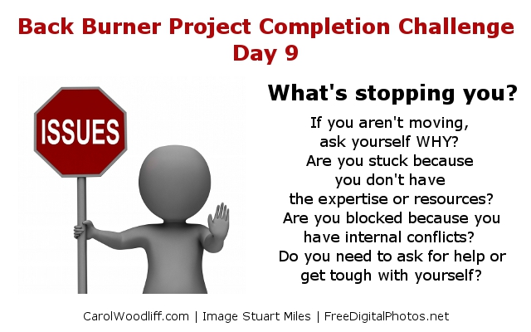
Project Execution and Control
Information and communication- key to team success !
The team project plan should have the answers to:
  How does the team measure and review progress?
  How does the team react to problems or changes?
  Major changes or problems often require re-planning; adjust and edit the plan !

Slide 14
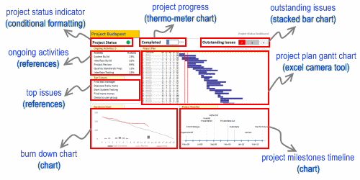
Basic Project Tools & Communication
Lists- Goals, Tasks, Team Members, Communication Information, Assignments,….
Charts- Schedule, Logistics, Relationships, Sequences, Information Flows, Processes,…
Graphs- Measured Quantities and Relationships, progress and expenses, risks
Some Project Reports are done as a single page using all of the above tools !

Slide 15
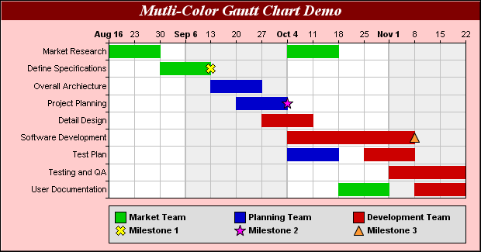
Gantt Chart

Slide 16
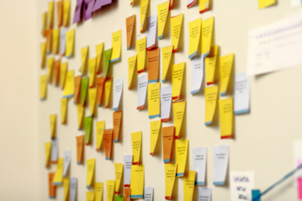
A example team tool…
Team tasks and associated team members or ideas need to be arranged into a plan…. How could you do it?

Slide 17
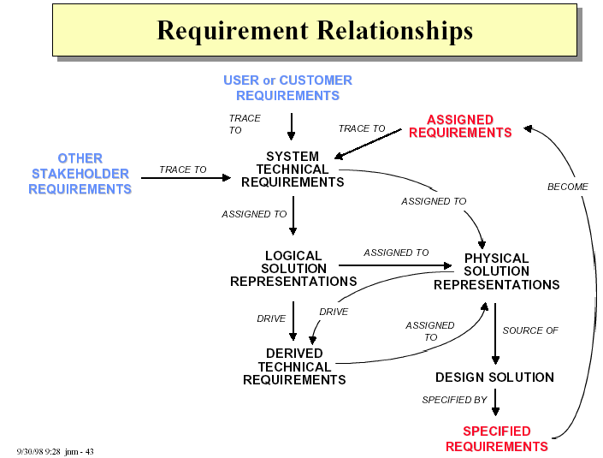

Slide 18
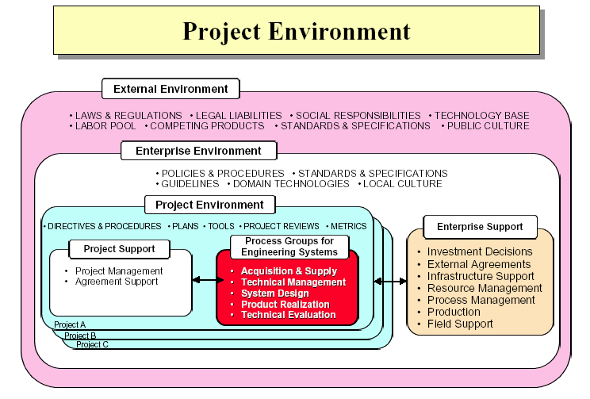

Slide 19
Measurements and Success
Questions to be answered in-process and at the end of the project:
  Are the project requirements (being)met? Are all requirements complete(or on track)?
Is every team member meeting their goals?
  If not, is that ok, and does the project plan reflect the differences?
  How can(could) the project work be improved? Do changes need to be made?
  Were(are) there any surprises, or unexpected events? What did the team learn from this?
  Does the team feel the project is a success? If not, why?

Slide 20
Summary
Work with your team to:
Understand each other and the team environment, and what needs to be learned
Identify what the project is, and what you have to work with, and when you are done
Decide how to do the project, who does what, and start working when ready
Be as organized as the project needs, be aware of and communicate project activity
Don’t hide problems !
Use appropriate simple tools:
make project work fun and rewarding, easy to complete, and the team proud to deliver !
Be careful of verbal only activity-
it can lead to team confusion and inefficiency & frustration…..

